Slide 1
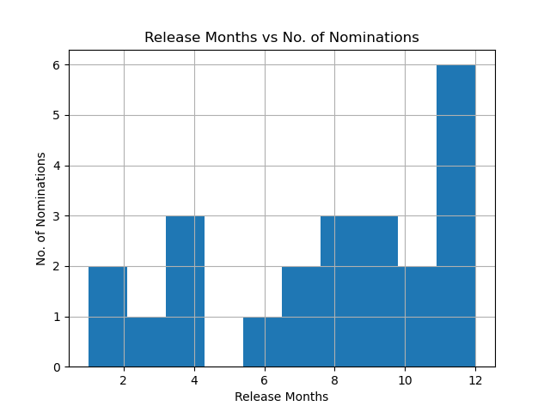
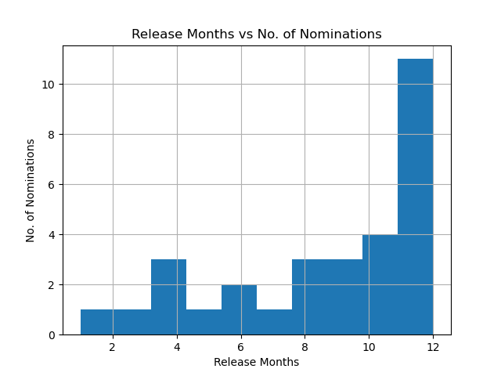
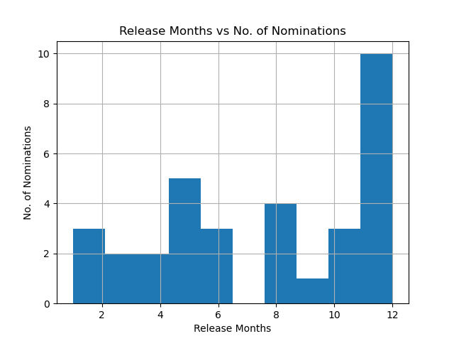
Histograms
2008
2013
2018
Notes:
By analysing all three histograms, the common factor shown in these pictures is number of nominations is at the highest for the months of November and December of the chosen years, which means that November and December have the most releases which they showcase and campaign to get a nomination for the Oscars. Another thing which I can relate to with Oscar season and these histograms is: Even though Nov and Dec have the most movies released and showcased, October is the start of the season. In these histograms, you could see October at a number of 2 or 3 nominations followed by a humongous increase of nominations in November or December, which translates to “The Oscar season begins in October with the first batch of releases, which are in small number, followed by a greater number of releases in November and December.” The movies which should be deemed as “Oscar-worthy” are mostly released from October to December to boost or capitalized this season, such that it remains fresh for critics and Academy Awards jury to earn a nomination. Comparing to these histograms, there used to be releases in June to August in 2008, while decreasing to half in 2013, and zero in 2018, which shows the these months are the “dump months”, which means the time period of releases which garners lowered expectations of films.

